Slide 1
GAR
Session 03: Snake
Notes:
Welcome. Today we build Snake. The main topic: assets as data.
Start by playing the finished game, Snake9, before any code.

Slide 2
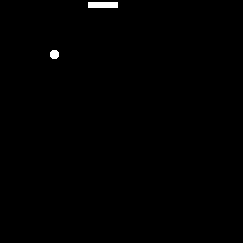
Snake
Snake goes back to Blockade (Gremlin, 1976). Image: Ustone07, CC BY-SA 3.0, via Wikimedia Commons.
Notes:
The original: Snake. Ask who has played it, and what they remember of how it plays.
Today we build the parts that matter for the architecture.

Slide 3
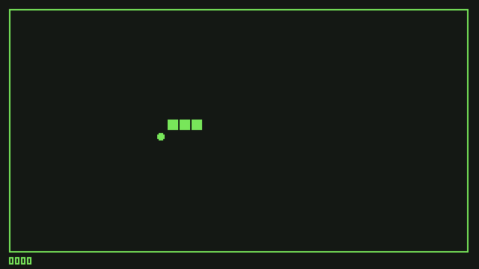
Today’s Goal
Notes:
Run Snake9 and play it for a minute.
Ask: what would you need to build this? Collect answers on the board, and come back to them at the end.

Slide 4
Today’s Topics
Main topic: Assets as data
Assets as Data
Texture Atlases
Sprites & Animation
Tilemaps
Fixed-Tick Movement
Input as Actions & Buffering
Collision Detection
Notes:
Today’s main topic is assets as data. The art, the animations and the room are described in XML, and the code only reads them.
Then movement on a fixed tick, and input as actions.

Slide 5
Source Code
github.com/Metamate/gar-games, folder 03-snake
Its README: the steps (Snake0 to Snake9), where things are in the code, how to run it
The course site: today’s concepts in full, the exercises, and questions to check yourself
Notes:
Open gar-games/03-snake live. Show the README: the step table, the code map, how to run a step.
Say: the site explains the ideas, the README helps you find them in the code, the slides are for today.

Slide 6
The Content Builder
One Content project, shared by every step. Builder.cs decides what happens to each file.
Content/Assets
images, XML
Builder.cs
rules, in C#
The content builder
runs on build
bin/.../Content
.xnb files, XML
PNG images become textures (magenta is see-through). XML definitions are copied as they are.
Notes:
Follow the pipeline left to right. The new part: all steps share one Content project.
Show Builder.cs: PNGs become textures, XML is copied as it is.

Slide 7
Assets as Data
The XML describes the assets; the code only reads it.
<Region name="head-1" x="8" y="0" width="7" height="7" />
<Region name="head-2" x="16" y="0" width="7" height="7" />
<Animation name="head-animation" delay="250">
<Frame region="head-1" />
<Frame region="head-1" />
<Frame region="head-1" />
<Frame region="head-1" />
<Frame region="head-1" />
<Frame region="head-2" />
</Animation>
A faster animation?
An extra frame?
A new room?
Which of these need a C# change?
Notes:
Read the three questions on the right, and let the class answer each.
Answer: none of them need C#. A faster animation is a delay, an extra frame is a Frame line, a new room is the tilemap file.

Slide 8
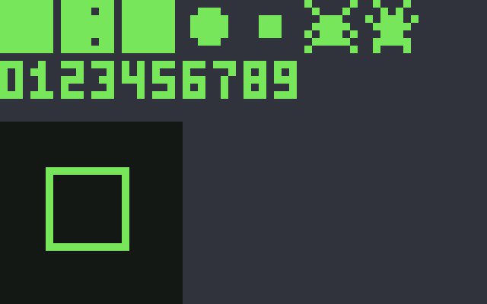




Optimizing Texture Rendering
body.png
head1.png
food1.png
digit0.png
atlas.png
Notes:
Many small images: a texture switch for every draw. One atlas: one texture, many regions. Fewer switches, faster drawing, one file to manage.

Slide 9
Texture Atlas
Notes:
The whole game’s art in one image.

Slide 10
Texture Region
Notes:
A region: a rectangle inside the atlas, with a name. We no longer reference a Texture2D directly; we ask the atlas for a region.

Slide 11
Texture Atlas Implementation
DEMO!
Snake0 → Snake1: from hardcoded rectangles to a texture atlas
Notes:
Demo: open Snake0 and Snake1 side by side (a diff tool, or two editor panes), then run Snake1.
- the hardcoded rectangles become names in atlas-definition.xml
- TextureAtlas.FromFile reads the XML
- Game1 asks for regions by name

Slide 12
Try It: Regions by Name
In Snake1, only atlas-definition.xml changes:
Draw the food with its second frame (x 32, y 0)
Then misspell food-1 in the XML. What happens, and when?
Notes:
Pairs, about 5 minutes, in Snake1. Moving the food-1 rectangle is enough; no C#.
Ask about the misspelling. Answer: the game stops at start-up (the atlas looks names up in a dictionary). A mistake in data only shows up when the game runs.

Slide 13
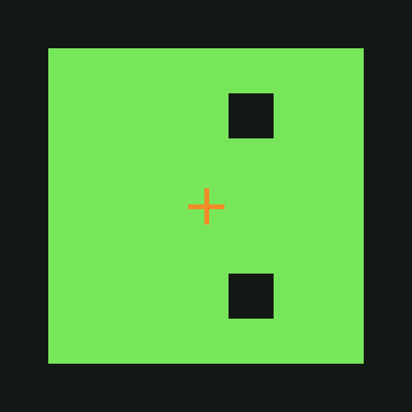
Sprites
Texture (region)
Rotation
Scale
Color mask
Origin
Sprite effects
Layer depth
Width
Height
CenterOrigin()
Draw(Spritebatch, Vector2)
Notes:
A sprite: a region plus how to draw it (rotation, scale, colour, origin). Point at the labels on the picture.

Slide 14
Sprite Implementation
DEMO!
Snake2: sprites
Notes:
Demo: open Snake1 and Snake2 side by side (a diff tool, or two editor panes), then run Snake2.
- the Sprite class in GARCore
- drawing through a sprite instead of the region

Slide 15
Try It: A Sprite
In Snake2:
Make the head bigger, and spin it the other way
Then remove CenterOrigin(). What changes, and why?
Notes:
Pairs, about 5 minutes. The rotation speed is a constant at the top of Game1; the scale is set in LoadContent.
Answer: without CenterOrigin the head spins around its top-left corner, because the origin is where rotation and scale start from.

Slide 16
Sprite Art
Draw it yourself, in a pixel editor such as Aseprite
Or use a free pack with a clear licence
Notes:
Where art comes from: draw it yourself (Aseprite is a good pixel editor), or use free packs with a clear licence.

Slide 17
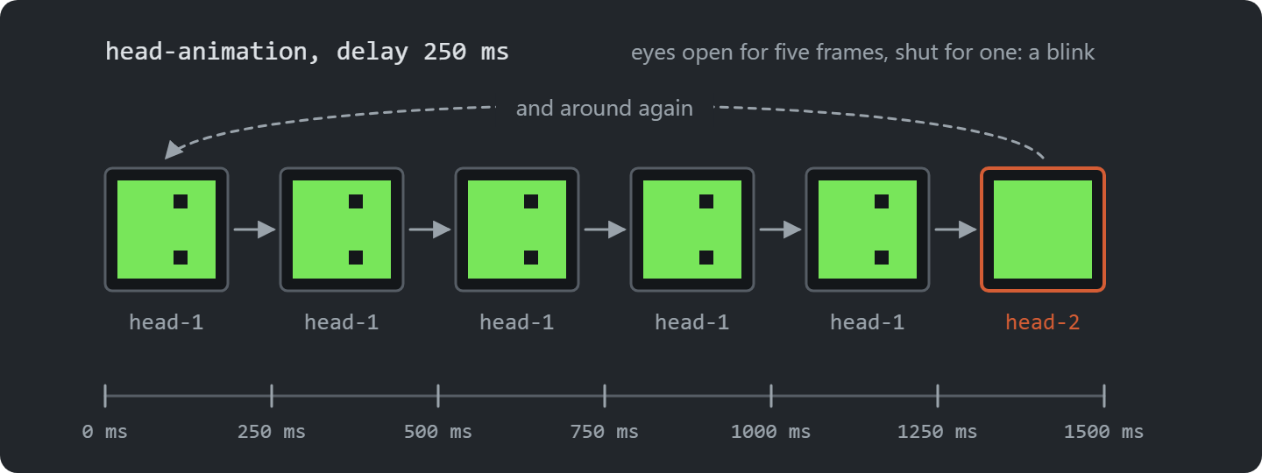
Animation
Notes:
An animation: a list of regions and a delay. The head at the bottom plays the frames above: five with its eyes open, one with them closed, so it blinks.

Slide 18
Animation Implementation
DEMO!
Snake3: animated sprites
Notes:
Demo: open Snake2 and Snake3 side by side (a diff tool, or two editor panes), then run Snake3.
- the Animations section of the XML
- AnimatedSprite advancing frames with elapsed time

Slide 19
Try It: Animation Speed
In the XML only:
Make the food pulse twice as fast, and the head blink less often
Give the food’s animation one more frame
Notes:
Pairs, about 5 minutes, in Snake3. The delay attribute and one more Frame line. Ask afterwards: how much C# did you change? None.

Slide 20

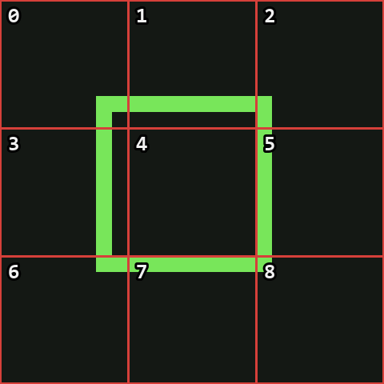
Tileset
Notes:
A tileset: an image cut into equal tiles, numbered left to right, top to bottom.

Slide 21

The Room: A Tilemap
00 01 01 01 02
03 04 04 04 05
03 04 04 04 05
06 07 07 07 08
Notes:
The numbers in the middle are the room. Find tile 4 (the floor) and the four corners together.

Slide 22
Tilemap Implementation
DEMO!
Snake4: the room, drawn from tilemap-definition.xml
Notes:
Demo: open Snake3 and Snake4 side by side (a diff tool, or two editor panes), then run Snake4.
- tilemap-definition.xml
- Tilemap.FromFile
- change one number, rebuild, and watch the room change

Slide 23
Try It: A New Room
In tilemap-definition.xml:
Rearrange the room: draw a wall across the middle
Then put a 9 in it. What happens, and when?
Notes:
Pairs, about 5 minutes, in Snake4.
The new wall doesn’t stop the snake: the tilemap is only a picture, and the room’s Rectangle decides. Answer for the 9: the tileset has 9 tiles (0 to 8), so the game fails when it draws the room. Same lesson as the misspelled region: data errors appear at runtime.

Slide 24
Fixed-Tick Movement
A snake jumps one cell at a time, however fast the game runs
An accumulator collects real time
  Move once for every full tick
  Subtract, don’t reset: leftover time carries over
Pong’s fixed timestep, in practice
TimeSpan TickDuration =
TimeSpan.FromMilliseconds(100);
public void Update(GameTime gameTime)
{
_elapsed += gameTime.ElapsedGameTime;
while (_elapsed >= TickDuration)
{
_elapsed -= TickDuration;
Move();
}
}
Notes:
The snake moves one cell per tick, however fast the game runs. The accumulator collects real time.
Ask: why subtract the tick, not reset to zero? Answer: the leftover time carries over, so ticks stay even.

Slide 25
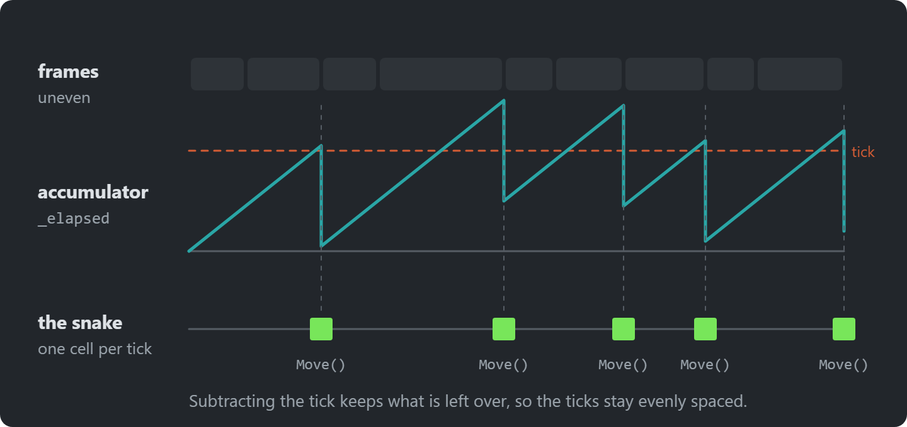
The Accumulator
Notes:
Frames are uneven; the accumulator collects their time. Every time it passes a tick, the snake moves once and one tick is subtracted.
Ask: what happens on a long frame? Answer: two moves in one frame, so the snake keeps its speed.

Slide 26
Input as Actions
Snake5 reads the keys directly
  Keys are hardwired to what they do
A GameController maps keys to actions
  The game asks for “up”, never for W
  The controls live in one place
Sokoban goes one step further: actions become objects
public static class GameController
{
public static bool Up =>
WasPressed(Keys.W) ||
WasPressed(Keys.Up);
// Down, Left, Right...
}
// In the game
if (GameController.Up)
_snake.Turn(Direction.Up);
Notes:
The game asks for Up, never for W. The keys live in one place, GameController.
Ask: what changes to support a gamepad? Answer: only GameController.

Slide 27
Input Buffering
The snake acts once per tick; the player can press twice between two ticks.
Up
Left
tick
tick
Keep only the last key:
Left overwrites Up, and the turn is lost.
Queue them (at most two):
Up on this tick, Left on the next.
The same trick lets a jump pressed just before landing still count.
Notes:
Act it out: press Up then Left quickly between two ticks. Keep only the last key and the Up is lost.
Queue them instead, at most two. Same idea as a jump pressed just before landing.

Slide 28
Movement & Input Implementation
DEMO!
Snake5 → Snake6 → Snake7: ticks, actions and buffering
Notes:
Demo: open Snake5 and Snake7 side by side (a diff tool, or two editor panes), then run Snake7.
- Snake5: the tick accumulator
- Snake6: GameController
- Snake7: the queue of turns

Slide 29
Try It: Ticks and Keys
In Snake7:
Make the snake twice as fast
Add I, J, K and L as a third set of keys
Which file did each change need?
Notes:
Pairs, about 7 minutes. Speed: TickDuration in Snake. Keys: GameController only.
If there is time: press two turns within one tick in Snake6, then in Snake7, and compare.

Slide 30
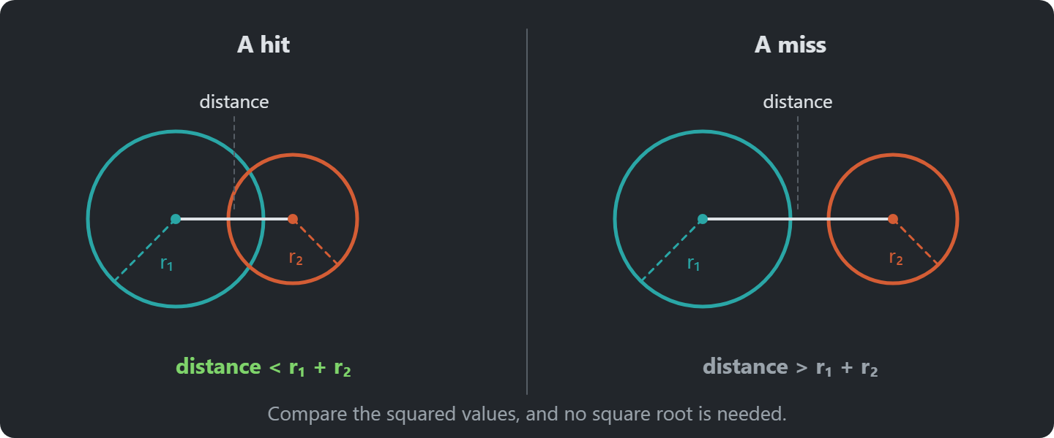
Collision Detection
Notes:
Three levels: distance, shapes (boxes, circles), polygons. Use the simplest that looks right.
AABB, Circles
Complex polygon checks

Slide 31
Circle Collision Detection
Why not Vector2.Distance?
Vector2 circle1Position = new(8, 10);
Vector2 circle2Position = new(5, 6);
float circle1Radius = 5;
float circle2Radius = 5;
// c^2 = 25
float distanceSquared = Vector2.DistanceSquared(circle1Position, circle2Position);
// r^2 = 100
float radiiSquared = (circle1Radius + circle2Radius) * (circle1Radius + circle2Radius);
// The circles overlap because 100 is greater than 25.
if (radiiSquared > distanceSquared)
{
}
Notes:
Ask the question: why not Vector2.Distance? Answer: it takes a square root. Compare squared distances instead: same answer, cheaper.

Slide 32
Collision Detection
Notes:
Circles or rectangles? Circles for round and rotating things; rectangles for boxes and tiles. Pick per object.

Slide 33
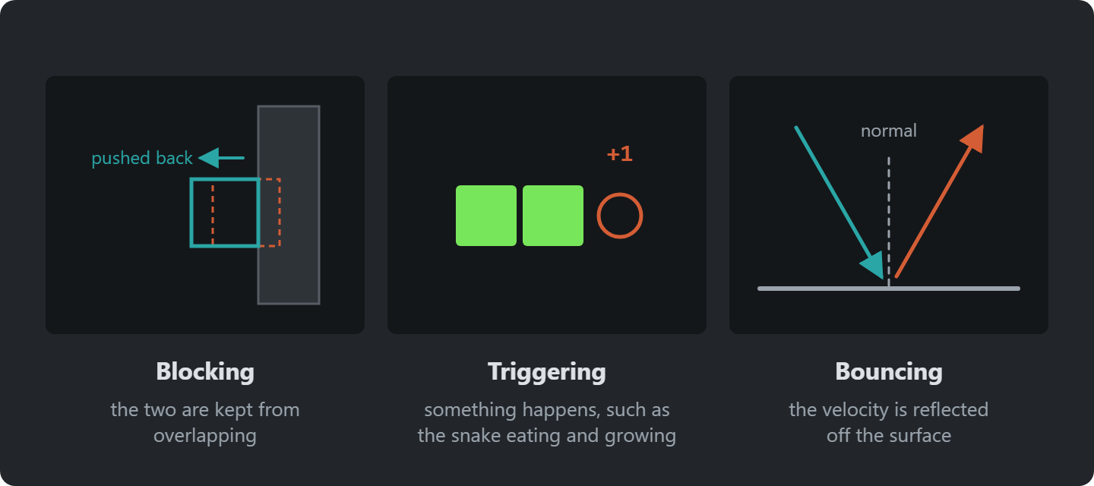
Collision Response
Notes:
Detection says they touch; response says what happens: block, trigger, or bounce (Vector2.Reflect).
Blocking to prevent objects from overlapping
Triggering events when objects collide
Bouncing to reflect objects off surfaces

Slide 34
Optimizing Collision Performance
Collision Detection is (often) the most expensive operation in a game engine
  n * (n - 1) / 2
  100 objects => 100 * 99 / 2 = 4950 collision checks every frame
Broad phase & Narrow phase
Notes:
Every pair: n(n−1)/2 checks. 100 objects, 4,950 checks a frame. Broad phase first (cheap, rough), narrow phase only for candidates.
Vampire Survivors comes back to this with a grid.

Slide 35
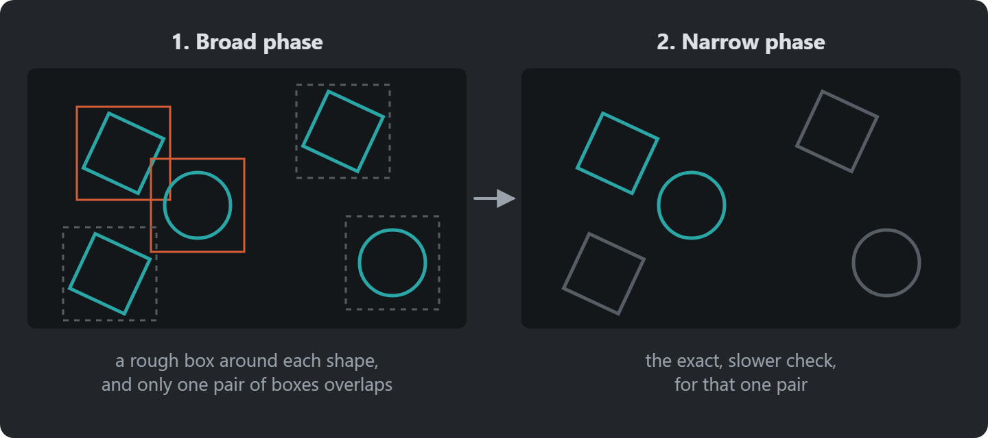
Broad Phase and Narrow Phase
Notes:
The broad phase is cheap and rough: boxes around the shapes, and only pairs whose boxes overlap go on.
The narrow phase runs the exact check on those pairs only. Vampire Survivors builds a broad phase, with a grid.

Slide 36
Refactoring Collisions to GARCore
MonoGame checks rectangles for us; circles we add to GARCore.
bool hit = a.Intersects(b); // Rectangle: AABB, built in
public readonly record struct Circle // GARCore
{
public bool Intersects(Circle other) => ... // squared distances, no square root
}
Why compare squared distances?
Notes:
Rectangles: MonoGame has Intersects. Circles: we add a Circle struct to GARCore.
Ask the question. Answer: squaring is cheap, square roots are not, and the comparison gives the same result.

Slide 37
Collision Implementation
DEMO!
Snake8 → Snake9: eating, growing and game over
Notes:
Demo: open Snake8 and Snake9 side by side (a diff tool, or two editor panes), then run Snake9.
- eating the food grows the snake and adds a point
- hitting itself or a wall ends the game

Slide 38
Exercise: A Bug From Data
A bug is in the atlas image, but not in the data
Describe it in atlas-definition.xml: two regions, one animation
Make the snake eat a bug: which line of C# changes?
How much C# did you change? And for a bug next to the food?
Notes:
Exercise: the bug is drawn in the atlas but not described. Two regions and an animation in the XML, then one line of C# (the animation name).
Ask afterwards: how much C# did you change? One string. And for a bug next to the food? A lot: Game1 handles the food by name (its field, its respawn, its collision). Data can’t fix that; it’s the next architecture problem.

Slide 39
Exercises
Start from Snake9, the finished game
Speed up: make the tick shorter every time the snake eats
Where does that rule belong?
New input: the D-pad, through a GamePadInfo in GARCore
Pause: while paused, the snake doesn’t move and turns aren’t buffered
Notes:
Start from Snake9. Ask for the speed-up exercise: where does that rule belong? In the snake, or in the game?
Gamepad: a press needs last frame’s state, so it goes through a GamePadInfo in GARCore. In the game, only GameController changes. Geometry Wars has a finished GamePadInfo to compare with.

Slide 40
Exercise: Refactor (Stretch)
The tick timer lives in the Snake class
Move it into a reusable FixedTimer class in GARCore
  It calls back on every tick
Use it for the snake
Notes:
For fast students: pull the tick timer out into a reusable FixedTimer in GARCore.

Slide 41
Check Yourself
Why prefer a texture atlas over many individual image files?
Why subtract the tick duration from the accumulator instead of resetting it?
What problems come from reading the keyboard inside gameplay code?
Why check a buffered turn against the last buffered direction?
The answers, and more questions, are on the course site.
Notes:
Ask one question at a time. Pairs discuss for a minute, then take two or three answers.
Expected answers (from the course site):
Q: Why prefer a texture atlas over many individual image files?
A: Drawing from one texture lets SpriteBatch batch many sprites into few draw calls. Switching textures between draws breaks the batch and costs performance.
Q: Why subtract the tick duration from the accumulator instead of resetting it to zero?
A: The leftover time carries over to the next tick. Resetting it would throw away a bit of time every tick, so the ticks would drift and depend on the frame rate.
Q: What problems come from reading the keyboard directly inside gameplay code?
A: Keys are hardcoded throughout the game, so rebinding, supporting a gamepad or letting an AI drive the same entity means editing gameplay code in many places.
Q: Why check a buffered turn against the last buffered direction?
A: The snake only turns on the next tick. Checking against its current direction would allow two quick turns that together reverse it into its own neck.

Slide 42
Apply It to Your Project
Which assets and settings are hardcoded, and could live in data files?
What are the actions in your game?
  List them separately from the keys and buttons that trigger them
Does anything in your game happen on a fixed tick?
Notes:
Give the project groups five minutes with these questions.
Ask two groups to share one answer each, and push them to name actual classes and files.

